Slide 1
COMP10001
Week 7

Slide 2
Why is it important to write comments for the code we write? Wouldn’t it save time, storage space and processing time to write code without comments?

Slide 3
Why is it important to write comments for the code we write? Wouldn’t it save time, storage space and processing time to write code without comments?
People look at code in the future (near or distant!) need to understand what it does and why we made certain choices when we wrote it

Slide 4
Why is it important to write comments for the code we write? Wouldn’t it save time, storage space and processing time to write code without comments?
People look at code in the future (near or distant!) need to understand what it does and why we made certain choices when we wrote it
Code is read more often than it is written!

Slide 5
Why is it important to write comments for the code we write? Wouldn’t it save time, storage space and processing time to write code without comments?
People look at code in the future (near or distant!) need to understand what it does and why we made certain choices when we wrote it
Code is read more often than it is written!
It might be quicker to write code if we didn’t write comments, but we would lose time trying to debug it later!

Slide 6
Why is it important to write comments for the code we write? Wouldn’t it save time, storage space and processing time to write code without comments?
People look at code in the future (near or distant!) need to understand what it does and why we made certain choices when we wrote it
Code is read more often than it is written!
It might be quicker to write code if we didn’t write comments, but we would lose time trying to debug it later!
Comments are discarded before code is run, so don’t affect run-time

Slide 7
What is a “docstring”? What is its purpose?

Slide 8
What is a “docstring”? What is its purpose?
A big comment at the top of a function that describes what it does

Slide 9
What is a “docstring”? What is its purpose?
A big comment at the top of a function that describes what it does
Should include:

Slide 10
What is a “docstring”? What is its purpose?
A big comment at the top of a function that describes what it does
Should include:
Inputs/arguments
Outputs
Briefly, what the function does

Slide 11
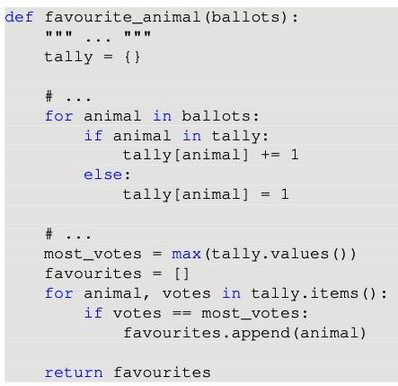
Exercise! Fill in the blanks with comments and a docstring
An example for ballots is['dog', 'pig', 'cat', 'pig', 'dog'], in which case the function returns ['dog', 'pig'].

Slide 12
What makes a good variable name? Why are good variable names important?

Slide 13
What makes a good variable name? Why are good variable names important?
Should accurately describe the thing they’re storing
Should allow code to be readable, so the reader can follow what the code is doing

Slide 14
What makes a good variable name? Why are good variable names important?
Should accurately describe the thing they’re storing
Should allow code to be readable, so the reader can follow what the code is doing
Bad variable names are arbitrary: a, b, c, lst, lst1, lst2, lsta, lstb

Slide 15
What makes a good variable name? Why are good variable names important?
Should accurately describe the thing they’re storing
Should allow code to be readable, so the reader can follow what the code is doing
Bad variable names are arbitrary: a, b, c, lst, lst1, lst2, lsta, lstb
Try to describe what the variable is storing, e.g. name instead of str

Slide 16
What are “magic numbers”? How do we write code without them using global constraints?

Slide 17
What are “magic numbers”? How do we write code without them using global constraints?
Constants written into our code as literals

Slide 18
What are “magic numbers”? How do we write code without them using global constraints?
Constants written into our code as literals
E.g. a threshold for a passing mark
if mark > 0.5:

Slide 19
What are “magic numbers”? How do we write code without them using global constraints?
Constants written into our code as literals
E.g. a threshold for a passing mark
Use global constants to make the purpose of magic numbers clear!
if mark > 0.5:

Slide 20
What are “magic numbers”? How do we write code without them using global constraints?
Constants written into our code as literals
E.g. a threshold for a passing mark
Use global constants to make the purpose of magic numbers clear!
if mark > 0.5:
PASS_MARK = 0.5
if mark > PASS_MARK:

Slide 21
What are “magic numbers”? How do we write code without them using global constraints?
Constants written into our code as literals
E.g. a threshold for a passing mark
Use global constants to make the purpose of magic numbers clear!
if mark > 0.5:
PASS_MARK = 0.5
if mark > PASS_MARK:
(Global constants are defined in the global namespace of our code, up the top, in capital letters. Their value doesn’t change.)

Slide 22
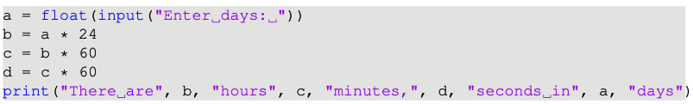
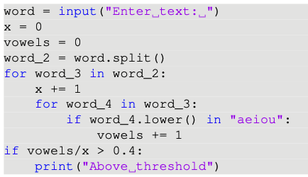
Consider the following programs. What are the problematic aspects of their variable name/use of magic numbers? What improvements would you make?

Slide 23
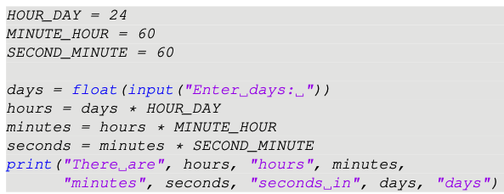
Consider the following programs. What are the problematic aspects of their variable name/use of magic numbers? What improvements would you make?

Slide 24
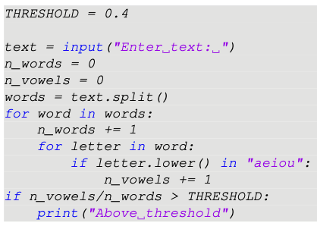
Consider the following programs. What are the problematic aspects of their variable name/use of magic numbers? What improvements would you make?

Slide 25
What do we mean by “mutability”? Which data types are mutable out of the ones we’ve seen?

Slide 26
What do we mean by “mutability”? Which data types are mutable out of the ones we’ve seen?
Mutable objects can be changed after they’re created

Slide 27
What do we mean by “mutability”? Which data types are mutable out of the ones we’ve seen?
Mutable objects can be changed after they’re created
Lists, dictionaries and set are mutable

Slide 28
What do we mean by “mutability”? Which data types are mutable out of the ones we’ve seen?
Mutable objects can be changed after they’re created
Lists, dictionaries and set are mutable
Immutable objects can’t be changed short of creating a new object
e.g. a += 1

Slide 29
What do we mean by “mutability”? Which data types are mutable out of the ones we’ve seen?
Mutable objects can be changed after they’re created
Lists, dictionaries and set are mutable
Immutable objects can’t be changed short of creating a new object
e.g. a += 1
Integers, floats, strings and tuples are immutable.

Slide 30
What is a “namespace”?

Slide 31
What is a “namespace”?
A mapping from names (of variables/functions) to objects.
Defines the collection of variables that can be used in a certain part of your program

Slide 32
What do we mean by “local” and “global” namespace? What is “scope”?
Global namespace is collection of all variable/function names available outside of any functions in a program

Slide 33
What do we mean by “local” and “global” namespace? What is “scope”?
Global namespace is collection of all variable/function names available outside of any functions in a program
When a function is called, it has a local namespace
This local namespace is unique to its execution and forgotten once it returns

Slide 34
What do we mean by “local” and “global” namespace? What is “scope”?
Global namespace is collection of all variable/function names available outside of any functions in a program
When a function is called, it has a local namespace
This local namespace is unique to its execution and forgotten once it returns
When a variable is referred to, Python looks in the most local namespace first, then checks less local namespaces, then finally the global namespace

Slide 35
What do we mean by “local” and “global” namespace? What is “scope”?
Global namespace is collection of all variable/function names available outside of any functions in a program
When a function is called, it has a local namespace
This local namespace is unique to its execution and forgotten once it returns
When a variable is referred to, Python looks in the most local namespace first, then checks less local namespaces, then finally the global namespace
We discourage the editing of global variables inside a function - it’s safer to return something from your function

Slide 36
What do we mean by “local” and “global” namespace? What is “scope”?
Global namespace is collection of all variable/function names available outside of any functions in a program
When a function is called, it has a local namespace
This local namespace is unique to its execution and forgotten once it returns
When a variable is referred to, Python looks in the most local namespace first, then checks less local namespaces, then finally the global namespace
We discourage the editing of global variables inside a function - it’s safer to return something from your function
Scope is the area of a program where a namespace is used. E.g. variables in a function’s local namespace are said to be in that function’s scope.

Slide 37
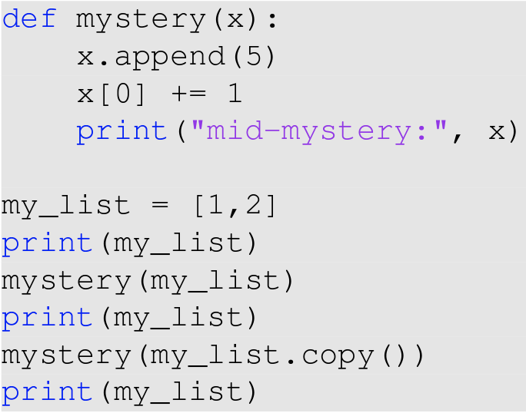
What is the output of this code?
Notes:
The mystery() function is a mutating function, as it changes the elements of the list argument it is given. In the first example, the function is called with the original list and therefore it is mutated: the value printed mid-mystery is reflected outside the function. The second time, a copy of the original list is passed as an argument, meaning any change made inside the function are not applied to the list, as we can see with how the last two lines printed are different. If the mystery()functionwerechangedtoalter a string, we would see that no matter how a string is passed into a function, it can never be mutated because it is an immutable type. Returning a new string is the only way to pass changes outside a function.

Slide 38
What is the output of this code?
[1,2]
Notes:
The mystery() function is a mutating function, as it changes the elements of the list argument it is given. In the first example, the function is called with the original list and therefore it is mutated: the value printed mid-mystery is reflected outside the function. The second time, a copy of the original list is passed as an argument, meaning any change made inside the function are not applied to the list, as we can see with how the last two lines printed are different. If the mystery()functionwerechangedtoalter a string, we would see that no matter how a string is passed into a function, it can never be mutated because it is an immutable type. Returning a new string is the only way to pass changes outside a function.

Slide 39
What is the output of this code?
[1,2]
Mid-mystery: [2,2,5]
Notes:
The mystery() function is a mutating function, as it changes the elements of the list argument it is given. In the first example, the function is called with the original list and therefore it is mutated: the value printed mid-mystery is reflected outside the function. The second time, a copy of the original list is passed as an argument, meaning any change made inside the function are not applied to the list, as we can see with how the last two lines printed are different. If the mystery()functionwerechangedtoalter a string, we would see that no matter how a string is passed into a function, it can never be mutated because it is an immutable type. Returning a new string is the only way to pass changes outside a function.

Slide 40
What is the output of this code?
[1,2]
Mid-mystery: [2,2,5]
[2,2,5]
Notes:
The mystery() function is a mutating function, as it changes the elements of the list argument it is given. In the first example, the function is called with the original list and therefore it is mutated: the value printed mid-mystery is reflected outside the function. The second time, a copy of the original list is passed as an argument, meaning any change made inside the function are not applied to the list, as we can see with how the last two lines printed are different. If the mystery()functionwerechangedtoalter a string, we would see that no matter how a string is passed into a function, it can never be mutated because it is an immutable type. Returning a new string is the only way to pass changes outside a function.

Slide 41
What is the output of this code?
[1,2]
Mid-mystery: [2,2,5]
[2,2,5]
Mid-mystery: [3,2,5,5]
Notes:
The mystery() function is a mutating function, as it changes the elements of the list argument it is given. In the first example, the function is called with the original list and therefore it is mutated: the value printed mid-mystery is reflected outside the function. The second time, a copy of the original list is passed as an argument, meaning any change made inside the function are not applied to the list, as we can see with how the last two lines printed are different. If the mystery()functionwerechangedtoalter a string, we would see that no matter how a string is passed into a function, it can never be mutated because it is an immutable type. Returning a new string is the only way to pass changes outside a function.

Slide 42
What is the output of this code?
[1,2]
Mid-mystery: [2,2,5]
[2,2,5]
Mid-mystery: [3,2,5,5]
[2,2,5]
Notes:
The mystery() function is a mutating function, as it changes the elements of the list argument it is given. In the first example, the function is called with the original list and therefore it is mutated: the value printed mid-mystery is reflected outside the function. The second time, a copy of the original list is passed as an argument, meaning any change made inside the function are not applied to the list, as we can see with how the last two lines printed are different. If the mystery()functionwerechangedtoalter a string, we would see that no matter how a string is passed into a function, it can never be mutated because it is an immutable type. Returning a new string is the only way to pass changes outside a function.

Slide 43
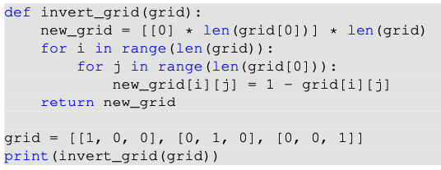
Something is wrong with this code. What will its output be? How could we fix it?

Slide 44
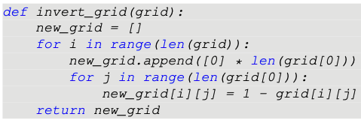
Something is wrong with this code. What will its output be? How could we fix it?

Slide 45
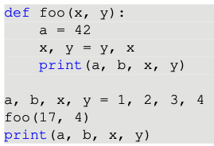
What is the output of the following code? Classify the variables by which namespace they belong in

Slide 46

What is the output of the following code? Classify the variables by which namespace they belong in

Slide 47
When is it useful to “return early”? How can it make out code safer and more efficient?

Slide 48
When is it useful to “return early”? How can it make out code safer and more efficient?
The answer is returned as soon as it is known, rather than waiting for a process to complete

Slide 49
When is it useful to “return early”? How can it make out code safer and more efficient?
The answer is returned as soon as it is known, rather than waiting for a process to complete
E.g. a searching function can return as soon as the thing it’s searching for is found, rather than checking things it hasn’t yet checked.

Slide 50
When is it useful to “return early”? How can it make out code safer and more efficient?
The answer is returned as soon as it is known, rather than waiting for a process to complete
E.g. a searching function can return as soon as the thing it’s searching for is found, rather than checking things it hasn’t yet checked.
This increases the efficiency of our programs!

Slide 51
What are helper functions? How do they make our code more reusable and readable?

Slide 52
What are helper functions? How do they make our code more reusable and readable?
Function that performs some small part of the computation of another function
Allow us to give descriptive names to bits of computation!
We can reuse a helper function if we need to do the same computation more than once!

Slide 53
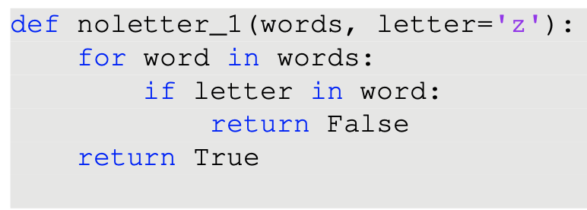
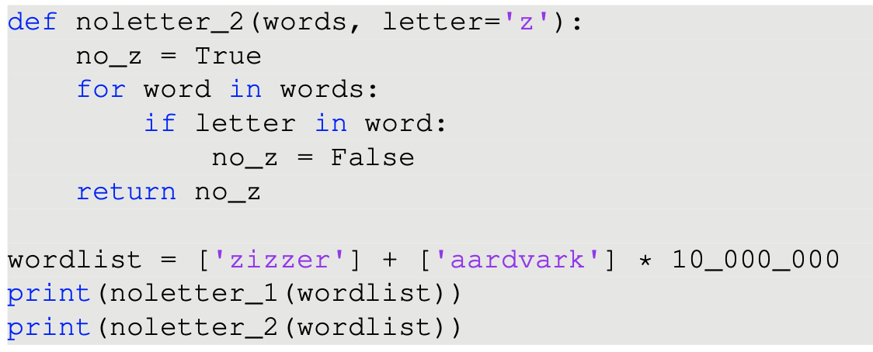
Compare the two functions. Are they equivalent?

